Slide 1
K S Institute of Technology Department of Computer Science and Engineering
Welcome to
2020-21 EVEN Semester
Online Class
System Modelling and Simulation
18CS645
Staff: Dr Rekha B Venkatapur

Slide 2
Vision and Mission of Institute
VISION
To impart quality technical education with ethical values, employable skills and research to achieve excellence.
MISSION
To attract and retain highly qualified, experienced and committed faculty.
To create relevant infrastructure
Network with industry and premier institutions to encourage emergence of new ideas by providing research and development facilities to strive for academic excellence
To inculcate the professional and ethical values among young students with employable skills and knowledge acquired to transform the society

Slide 3
Vision and Mission of Department
Vision:
“To create competent professionals in Computer Science and Engineering with adequate skills to drive the IT industry”
Mission:
M1: Impart sound technical knowledge and quest for continuous learning.
M2: To equip students to furnish Computer Applications for the society through experiential learning and research with professional ethics.
M3: Encourage team work through inter-disciplinary project and evolve as leaders with social concerns.

Slide 4
Program Educational Objectives
PEO1: Excel in professional career by acquiring knowledge in cutting edge technology and contribute to the society as an excellent employee or as an entrepreneur in the field of Computer Science Engineering.
PEO2: Continuously enhance their knowledge on par with the development in IT industry and pursue higher studies in Computer Science & Engineering.
PEO3: Exhibit professionalism, cultural awareness, team work, ethics, and effective communication skills with their knowledge in solving social and environmental problems by applying computer technology.

Slide 5
Program Specific Outcomes(PSOs)
PSO1: Ability to understand, Analyze and implement programs in programming languages, as well apply concepts in core areas of Computer Science.
PSO2: Ability to use Computational skills in Mathematics, Algorithms and apply software knowledge to develop projects based on architecture of the system, data analysis to solve Real world problems.
PSO3: Ability to participate in Teams and use computer knowledge in various domains to become successful Entrepreneur.

Slide 6
Course Learning Outcomes:
After completing the course, the students will be able to,
Bloom’s Level
18CS645.1 | Identify the System components and apply analytical modeling methods to simulate the activities of systems- Queuing, inventory & reliability. | Applying (K3)
18CS645.2 | Make use of the characteristics of a Discrete system and Event scheduling time advance algorithm to model the Single Queuing Simulation in Java. Identify useful statistical models, discrete and continuous distributions. | Applying (K3)
18CS645.3 | Model the behaviour of M/G/1 queue behaviour with measures of performance of queuing systems, Random number and variate generation, Tests for random numbers. | Applying (K3)
18CS645.4 | Identify the steps in Input Modelling by choosing parameters, Solve Goodness of fit tests problems. | Applying (K3)
18CS645.5 | Apply effective verification, calibration and validation of methods, Plan Optimization through Simulation. | Applying (K3)

Slide 7

Chapter 1 Introduction to
Simulation
Banks, Carson, Nelson & Nicol
Discrete-Event System Simulation

Slide 8



Outline
When Simulation Is the Appropriate Tool
When Simulation Is Not Appropriate
Advantages and Disadvantages of Simulation
Areas of Application
Systems and System Environment
Components of a System
Discrete and Continuous Systems
Model of a System
Types of Models
Discrete-Event System Simulation
8

Slide 9

Definition
A simulation is the imitation of the operation of real-world process or system over time.
Generation of artificial history and observation of that observation history
A model construct a conceptual framework that describes a system
The behavior of a system that evolves over time is studied by developing a simulation model.
The model takes a set of expressed assumptions:
Mathematical, logical
Symbolic relationship between the entities
9

Slide 10

Goal of modeling and simulation
A model can be used to investigate a wide verity of “what if” questions about real-world system.
Potential changes to the system can be simulated and predicate their impact on the system.
Find adequate parameters before implementation
So simulation can be used as
Analysis tool for predicating the effect of changes
Design tool to predicate the performance of new system
It is better to do simulation before Implementation.
10

Slide 11

How a model can be developed?
Mathematical Methods
Probability theory, algebraic method ,…
Their results are accurate
They have a few Number of parameters
It is impossible for complex systems
Numerical computer-based simulation
It is simple
It is useful for complex system
11

Slide 12

When Simulation Is the Appropriate Tool
Simulation enable the study of internal interaction of a subsystem with complex system
Informational, organizational and environmental changes can be simulated and find their effects
A simulation model help us to gain knowledge about improvement of system
Finding important input parameters with changing simulation inputs
Simulation can be used with new design and policies before implementation
Simulating different capabilities for a machine can help determine the requirement
Simulation models designed for training make learning possible without the cost disruption
A plan can be visualized with animated simulation
The modern system (factory, wafer fabrication plant, service organization) is too complex that its internal interaction can be
treated only by simulation
12

Slide 13

When Simulation Is Not Appropriate
When the problem can be solved by common sense.
When the problem can be solved analytically.
If it is easier to perform direct experiments.
If cost exceed savings.
If resource or time are not available.
If system behavior is too complex.
□ Like human behavior

Slide 14

Advantages and disadvantages of simulation
In contrast to optimization models, simulation models are “run” rather than solved.
□ Given as a set of inputs and model characteristics the model is run and the simulated behavior is observed

Slide 15
Advantages of simulation
New policies, operating procedures, information flows and son on can be explored without disrupting ongoing operation of the real system.
New hardware designs, physical layouts, transportation systems and … can be tested without committing resources for their acquisition.
Time can be compressed or expanded to allow for a speed-up or slow-down of the phenomenon( clock is self-control).
Insight can be obtained about interaction of variables and important variables to the performance.
Bottleneck analysis can be performed to discover where work in process, the system is delayed.
A simulation study can help in understanding how the system operates.
“What if” questions can be answered.

Slide 16

Disadvantages of simulation
Model building requires special training.
Vendors of simulation software have been actively developing packages that contain models that only need input (templates).
Simulation results can be difficult to interpret.
Simulation modeling and analysis can be time consuming and expensive.
Many simulation software have output-analysis.

Slide 17
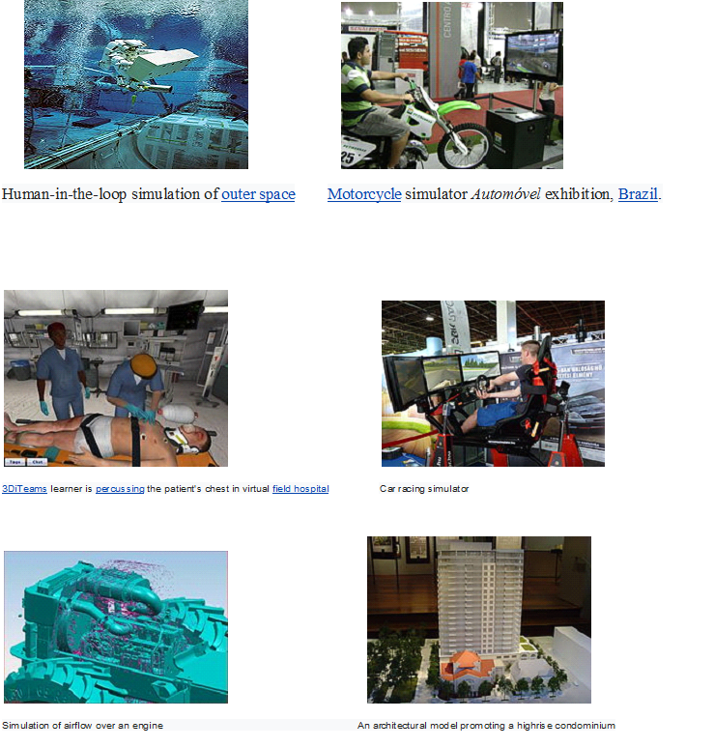
Applications of Simulation
.

Slide 18

Areas of application
Manufacturing Applications
Semiconductor Manufacturing
Construction Engineering and project management
Military application
Logistics, Supply chain and distribution application
Transportation modes and Traffic
Business Process Simulation
Health Care
Automated Material Handling System (AMHS)
Test beds for functional testing of control-system software
Risk analysis
Insurance, portfolio,...
Computer Simulation
CPU, Memory,…
Network simulation
Internet backbone, LAN (Switch/Router), Wireless, PSTN (call center),...

Slide 19

Systems and System Environment
A system is defined as a groups of objects that are joined together in some regular interaction toward the accomplishment of some purpose.
An automobile factory: Machines, components parts and workers operate jointly along assembly line
A system is often affected by changes occurring outside the system: system environment.
Factory : Arrival orders
Effect of supply on demand : relationship between factory output and arrival (activity of system)
Banks : arrival of customers

Slide 20

Components of system
Entity
An object of interest in the system : Machines in factory
Attribute
The property of an entity : speed, capacity
Activity
A time period of specified length :welding, stamping
State
A collection of variables that describe the system in any time : status of machine (busy, idle, down,…)
Event
A instantaneous occurrence that might change the state of the system: breakdown
Endogenous
Activities and events occurring with the system
Exogenous
Activities and events occurring with the environment

Slide 21

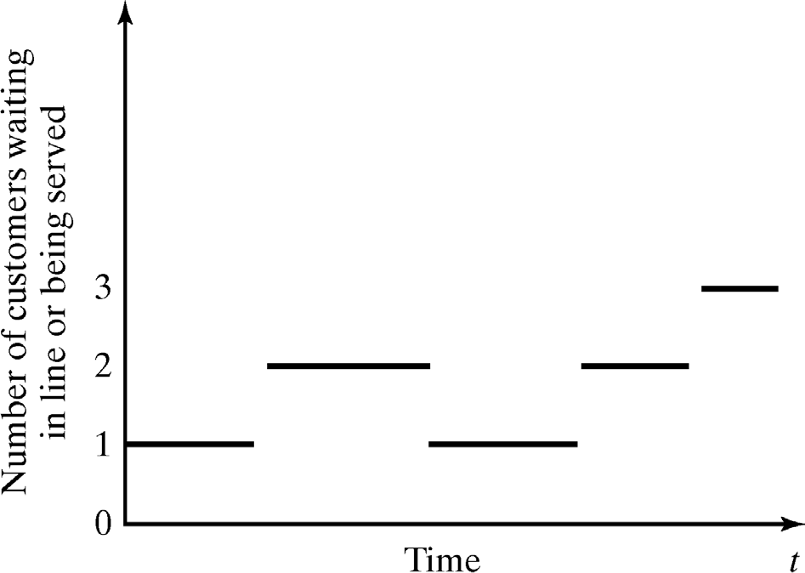
Discrete and Continues Systems
A discrete system is one in which the state variables change only at a discrete set of points in time : Bank example

Slide 22

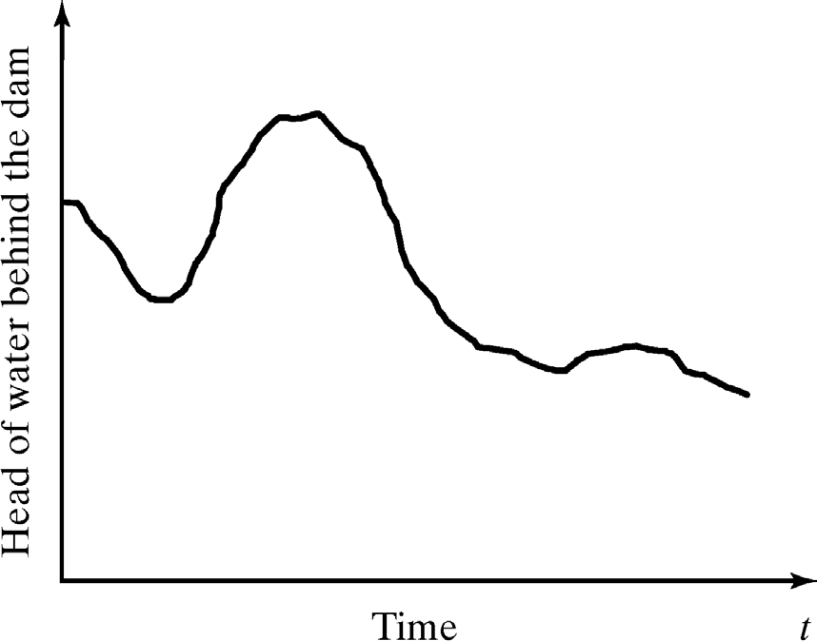
Discrete and Continues Systems (cont.)
A continues system is one in which the state variables change continuously over time: Head of water behind the dam

Slide 23
Model of a System
To study the system
it is sometimes possible to experiments with system
This is not always possible (bank, factory,…)
A new system may not yet exist
Model: construct a conceptual framework that describes a system
It is necessary to consider those accepts of systems that affect the problem under investigation (unnecessary details must remove)

Slide 24
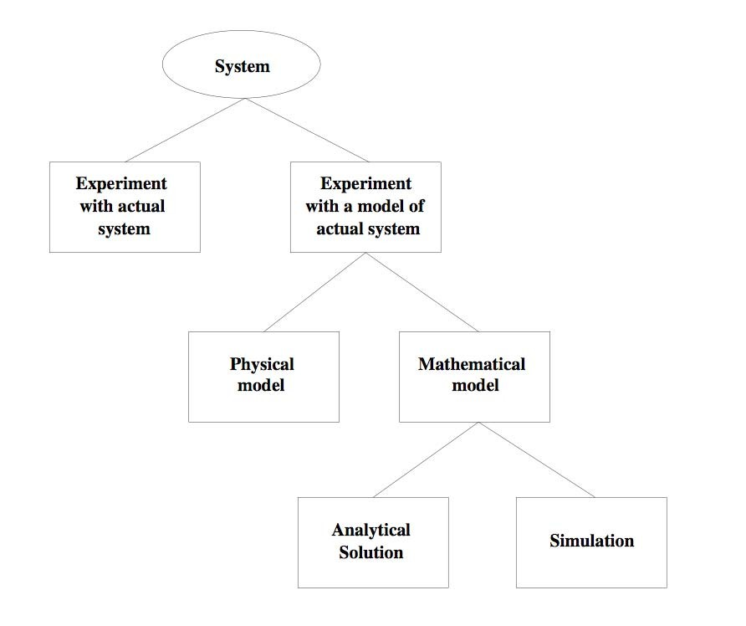
Types of Models
1
23

Slide 25
Characterizing a Simulation Model
Deterministic or Stochastic
Does the model contain stochastic components?
Randomness is easy to add to a DES
Static or Dynamic
Is time a significant variable?
Continuous or Discrete
Does the system state evolve continuously or only at discrete points in time?
Continuous: classical mechanics
Discrete: queuing, inventory, machine shop models

Slide 26

Discrete-Event Simulation Model
Stochastic: some state variables are random
Dynamic: time evolution is important
Discrete-Event: significant changes occur at discrete time instances

Slide 27
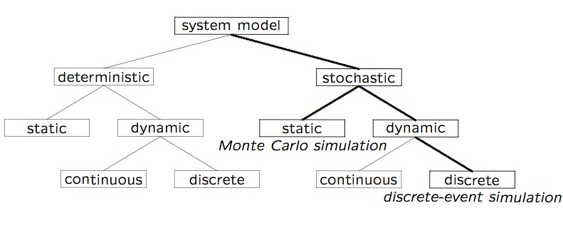
Model Taxonomy

Slide 28
DES Model Development
How to develop a model:
Determine the goals and objectives
Build a conceptual model
Convert into a specification model
Convert into a computational model
Verify
Validate
Typically an iterative process

Slide 29

Three Model Levels
Conceptual
Very high level
How comprehensive should the model be?
What are the state variables, which are dynamic, and which are important?
Specification
On paper
May involve equations, pseudocode, etc.
How will the model receive input?
Computational
A computer program
General-purpose PL or simulation language?

Slide 30

Verification vs. Validation
Verification
Computational model should be consistent with specification model
Did we build the model right?
Validation
Computational model should be consistent with the system being analyzed
Did we build the right model?
Can an expert distinguish simulation output from system output?
Interactive graphics can prove valuable

